Slide 1


Slide 2


Setting up shop for .NET MAUI
Gerald Versluis
Software Engineer .NET MAUI Team

Slide 3




How does .NET MAUI work?
.NET Multi-platform App UI
.NET for Android
.NET for iOS / Mac Catalyst
WinUI
.NET Base Class Library (BCL)
App Code
.NET Runtime
Android
iOS
macOS
Windows
iOS
macOS
Notes:
Now, before we dive into the practical part, let’s make sure that we understand all the moving parts here. Let’s have a look at how a .NET MAUI app is actually constructed under the hood.
How is it native?
Everything starts with your app code. This is where you want to spend all your time being productive. And you want to deliver your app on 1+ devices
The first layer of the technology cake is the native platform SDK. This what Google, Android, and Microsoft ship for those platforms
So how do we get from our .NET app code to those platforms and running on devices?
First we need something that can run .NET code: the .NET Runtime. (Yes, it uses MonoVM on mobile and Mac, and CoreCLR on Windows, but that’s not terribly important because...)
Next we need a common .NET API we can write our code against, and that’s the Base Class Library (BCL). New in .NET 6 app runtimes use the same BCL.
To use .NET against native platform SDKs we need a .NET representation of them. We do this via binding a .NET API and implementation to the native API. When you call a native method from C#, it’s just as if you had done it from Obj-C, Swift, Java, Kotlin, or C++.
The final layer of the cake that really makes it delicious is .NET MAUI. .NET MAUI provides a rich library of controls, layouts, and services that work across all of the platforms supported, so you need only master one API to get native apps.
(next slide) With .NET MAUI, all of that complexity is delivered in a single framework that gives you access to it all.

Slide 4
How does .NET MAUI work?
App Code
.NET Multi-platform App UI
iOS
macOS
Notes:
With .NET MAUI, all of that complexity is delivered in a single framework that gives you access to it all.

Slide 5
Supported Platforms
Notes:
As you can see, there is a lot to unpack here. We are suddenly trying to work with tools that work with Android, iOS & macOS and of course Windows. Don’t worry! I will walk you through it so you will have a good idea on how to make all this work on your machine. First let’s establish the prerequisites here.

Slide 6

Supported Platforms
Android 5.0 (API 21) or higher
iOS 10 or higher
macOS 11.15 or higher, using Mac Catalyst
Windows 10 version 1809 or higher, using WinUI
For .NET MAUI Blazor:
Android 7 (API 24) or higher
iOS 14 or higher
macOS 11 or higher, using Mac Catalyst
Source: https://docs.microsoft.com/dotnet/maui/supported-platforms
Notes:
Here you can see all the platforms that we support with .NET MAUI. The numbers you are seeing here are the platforms that you can _target_ so the platforms that you can write apps for.
Besides regular .NET MAUI apps we also have .NET MAUI Blazor or Blazor Hybrid which has slightly higher requirements.

Slide 7

Tooling to Build .NET MAUI Apps
.NET 6 or higher
CLI
Visual Studio 2022 (Preview)
Visual Studio for Mac 2022 (Preview)
XCode
Community Edition is enough to get started for FREE!
https://visualstudio.microsoft.com/downloads/
Notes:
So what tooling is required and can be used to build .NET MAUI apps? You’ll need .NET 6, or by November .NET 7 with the .NET MAUI workload installed. Then on Windows you can use Visual Studio 2022. At the time of this session you will need the preview version. .NET MAUI is generally available, but the tooling is still in preview so that’s why you still want to use the preview version. Hopefully this changes soon!
On a Mac you will want to use Visual Studio for Mac 2022 which is also in preview right now. Additionally, to make it work for iOS anc macOS you will need to install Xcode.
For Android you also need the SDKs and tools for that, but they will be brought in automatically both on Windows and on Mac so you shouldn’t have to be worried about that.
The best news is that you can get started absolutely for free! The community edition of Visual Studio is enough to be able to install .NET MAUI and start developing your apps

Slide 8


Target vs Development Platform
Target Platform 👉 Development Platform 👇 | Windows | Android | iOS | macOS
Windows
macOS
*
* A Mac is required (on the network)
Notes:
Here is a quick overview of all the platforms that you can develop _on_ and develop _for_ with .NET MAUI. So horizontally you can see all the platforms that you can develop apps for and vertically you can see all the platforms that you can use to develop .NET MAUI apps with.
You can see that there is basically 2 combinations that are not possible which is the desktop platforms: you can’t develop macOS on Windows and you can’t develop Windows on macOS.
Developing iOS on Windows is possible, but you will still need to connect it to Mac hardware:
Buy a Mac (Mini is probably cheapest)
Rent a Mac in the cloud
Use Hot Restart to connect your physical iOS device to Windows
We will learn how to connect a Mac over the network in a minute

Slide 9
.NET MAUI Development By Platform

Slide 10
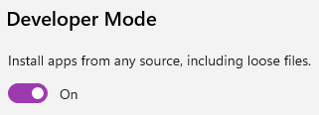
Targeting Windows
Be aware of Windows Home Edition!
Enable Developer Mode in Windows 10 & 11
Under Settings, Privacy & security > For developers
Visual Studio should suggest this when debugging

Slide 11

Targeting Android
On Windows: virtualization is hard…
https://docs.microsoft.com/dotnet/maui/android/emulator/hardware-acceleration
Enable Developer Mode
Under Settings, About Phone tap the Build Number 7 times until it says you’re now a developer
Notes:
If you are going to develop for Android on Windows, you might run into some challenges when running the emulator. It will mostly be fine out of the box, but you might run into some challenges when trying to run the emulator. On macOS this is much easier.
If you want to run on a physical device, be sure to enable Developer Mode!

Slide 12
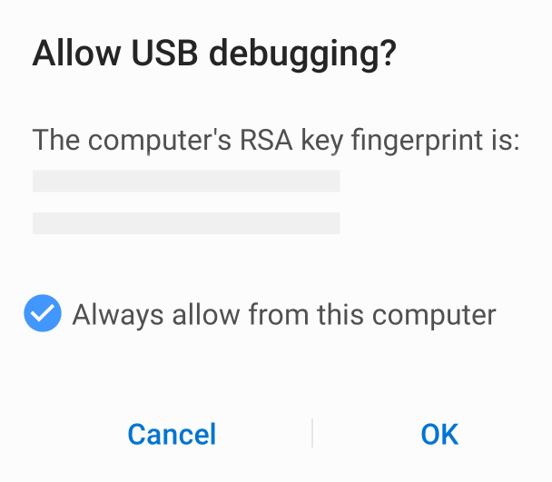
Targeting Android
Under Settings find Developer Options and make sure USB Debugging is on.
Connect the USB cable and you get a dialog like underneath
Notes:
Windows Subsystem for Android mention

Slide 13
Targeting iOS & macOS
It just works!
iOS has introduced a Developer Mode, not required for deploying (yet)
macOS has a sandbox
Notes:
For iOS and macOS it mostly just works.
iOS did introduce a developer mode since iOS 16 which is now in beta, but it doesn’t seem to be enabled for deploying debug versions just yet. But who knows what might happen in the future.
macOS has a sandbox built-in so you might run into needing to give permissions for some things, but I find that it mostly just works. Be aware that running the debugging version on your machine has more permissions that running a release version because of said sandbox so make sure. To test both!

Slide 14
Demo
Setting up Visual Studio 2022 on Windows
Notes:
I won’t go over all the things that I have just talked about, mainly actually deploying the debug applications, but I will show you how to set it all up and afterwards you should be able to deploy your apps to all platforms.
Show Visual Studio Installer with .NET MAUI workload
How to connect your Mac
Setup an Android emulator
Enable Windows Developer Mode

Slide 15
References
Official Docs: https://docs.microsoft.com/dotnet/maui
.NET MAUI for Beginners videos: https://www.youtube.com/playlist?list=PLdo4fOcmZ0oUBAdL2NwBpDs32zwGqb9DY
.NET MAUI Learn Module: https://docs.microsoft.com/en-us/learn/paths/build-apps-with-dotnet-maui/
Geralds YouTube channel: https://youtube.com/GeraldVersluis

Slide 16

Thanks for joining!
Ask your questions live on Twitter #dotNETConf
Notes:
Thank you so much for joining my session, you and your development machine should now be prepared to build amazing .NET MAUI apps. Enjoy the rest of this .NET Conf event with the amazing line-up that is ahead! Back to you James.

Slide 17









Slide 18








Slide 19








Slide 20








Slide 21





Slide 22


Slide 23


Slide 24


Slide 25


Slide 26


